Slide 1
miLEAD Consultant Training Slide Presentation
Kaylee Steen
Tyler McCullough
Hannah Chia
Mike McMillan
Daniella Patton
Zach Reese
Consultants :
Genesis Rodriguez
Srihari Sundar
Advisors: miLEAD Board Members
Yuan Li
Ellie Frydendall

Slide 2
Slide Presentation
miLEAD Training Module
Basic features of miLEAD slide design | 3
Slide elements | 9
Example slides - Urinary Tract Infections | 22
Example slides - Agricultural Robots | 33
miLEAD has fixed theme and features for slides used in presentations. They work to show professionalism as well as to brand the miLEAD consulting group. Click ahead to see more.
Next

Slide 3
Basics of miLEAD Slide Design
Back
Next

Slide 4


Basics of Slide Design
The miLEAD Slide Template
miLEAD has a specific template that is used for all client presentations.
The miLEAD Template
All slides created for project presentations must be made using this template
Do NOT move, resize, or alter any aspects of the template, especially the takeaway box
Every slide must have a lead-in and takeaway box (aside from very specific circumstances)
Font (Calibri) and color scheme should be maintained on all slides
Project managers will make all template changes including the date and footer
The miLEAD slide template is used for all presentations created during projects and to be presented to a client.
Back
Next

Slide 5
A
Basics of Slide Design
B
Overview of Slide Elements
C
A lead-in provides a very brief overview of the content within the slide.
A
Section Header
Denotes the section of the presentation the slide is in
B
Slide Header
Title of the specific slide
C
Lead-In Statement
A brief statement that provides an overview of the conclusions
D
Takeaway Box
A conclusive statement that summarizes the statements presented in the slide
E
Footer
Denotes the client this presentation was made for (can only be changed by PM)
D
A takeaway box delivers a conclusive statement on the slide’s content and should be written such that it could stand alone on the slide.
E
Back
Next

Slide 6
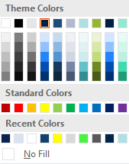
Basics of Slide Design
Color Scheme
Color schemes should be consistent across all slides.
Color Tips
Only use colors within the built-in miLEAD theme
Splashes of color on charts/headers are good
Excessive contrasting color becomes distracting
Dark/light blue should be primarily used, with greens and purples being used sparingly on charts
Dark Blue
#0A234E
Light Blue
#AEDFE3
Gray
#E7E6E6
Green
#90E9D0
Blue
#204D79
Purple
#7030A0
miLEAD’s Color Scheme
miLEAD has a defined color scheme which should be maintained throughout all slides for graphs, headers, text boxes, etc.
Back
Next

Slide 7
Basics of Slide Design
Design Tips
Slides should present a clear message in a clean format.
1
Limit the amount of text on a page
Figures and images are worth more than bullet points
2
Consistency is key
Fonts, colors, text size and chart formats should be maintained across all slides
3
Keep it simple
Slides should have a clear, concise message with one slide, one idea
4
Avoid distracting graphics
Animations and busy images distract from content
Slides should be designed to be easily digestible and present a clear, concise message without being cluttered by excess text and obnoxious graphics.
Back
Next

Slide 8
Slide Presentation
miLEAD Training Module
Basic features of miLEAD slide design | 3
Slide elements | 9
Example slides - Urinary Tract Infections | 22
Example slides - Agricultural Robots | 33
Apart from the fixed features, miLEAD slides contain certain elements to emphasize and organize data graphs, icons, and visual motifs in order to break up text- and number-heavy information.
Back
Next

Slide 9
Slide Elements
Back
Next

Slide 10
Slide Elements
Representing Text-based Information
Text-based slides are unavoidable in presentations, therefore extra polishing is needed to make them easy to read.
Currently, only 5-10% patients are being referred for ablation procedures by cardiologists.
When is ablation prescribed?
When is ablation NOT prescribed?
Refractory, Very symptomatic Paroxysmal AF
Younger patient (<70 yrs)
No major co-morbid conditions
Cannot be overweight: less than 270/300lbs.
Failure of AADs and electro cardioversion
When long-term anti-coagulants are not favorable
Asymptomatic AF, High age group (>85 yrs)
Having co-morbid conditions including Hypertension, thyroid, mitral valve disease, thyroid toxicosis, Diabetes, sleep apnea and Secondary hyper-thyroidism
Previous history of stroke, anatomic structural changes in the heart, calcified vessels
Text in slides should be kept to minimal, but necessary text can be organized by boxes and bullet points.
Back
Next

Slide 11
Slide Elements
Presenting Primary Research Data
Data from interviews are often presented as quotes and message boxes.
1. Quotes
When the quote lacks meaning by itself, a context can be provided in square brackets.
[Improvements in lowering toxicity and side effects are needed because] “right now patients have to trade off one problem with dangerous side effects”.
- Electrophysiologist
[Unmet need in anti-coagulation medication options.] “Reliable rhythm control drugs.”
- Cardiologist
2. Message box – present data with a small sample size
When conducting primary research through interviews, the sample size is often too small to be presented properly in graphs. Therefore a message box can be used to summarize the findings.
Cost of hospitalizations (3/3 payers) and medical devices (2/3 payers) were top concerns in expenses for payers.
Data from primary research can be used to validate your points in the form of auxiliary box.
Back
Next

Slide 12
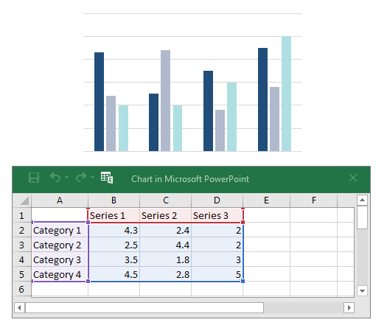
Slide Elements
Charts and Graphs Overview
Charts and graphs are essential components of a presentation.
Chart/Graph Tips
All charts/graphs must be made in PowerPoint by directly editing values (right-click, Edit Data)
Limit each slide to one or two charts in order to reduce slide clutter and ensure a cohesive message
Include axes, labels, and titles on all charts
Consider including value labels on each graph to improve effectiveness
Less is more, fade or remove grid lines and keep color consistent to increase readability
Charts and graphs are integral to a miLEAD presentation and must be created directly in PowerPoint to be easily editable.
Back
Next

Slide 13
Slide Elements
Bar Graphs
Bar graphs are great for survey data and for comparing values.
Uses
Show values on graph
Bar graphs are used for a direct comparison of values
Comparison of company revenue
Survey results
Data sorted over a week by day
Tips
Horizontal bar graphs are another effective visualization, especially to avoid clutter
Bar graphs can display change over time data when the changes are very large
Bar graphs are best for a direct comparison of values and can be displayed horizontally or vertically depending on the data being conveyed.
Back
Next

Slide 14
Slide Elements
Line Graphs
Line graphs are used to demonstrate growth or decline over time.
Uses
Trends over time to demonstrate either growth or decline
Revenue over years
Market growth
Competitors market share over time
Tips
Can be effectively used in combination with a bar graph
If using multiple graphs with different axes, ensure that it is easily understandable
Consider adding labels
Line graphs are great at showing trends over time and can be used in conjunction with a bar graph to highlight trends.
Back
Next

Slide 15
Slide Elements
Pie Charts
Pie charts have niche uses and should be carefully implemented or avoided when looking at larger datasets.
Uses
Any data that represents parts of a whole
Market share
Annual revenue by quarter
Revenue segmentation
Survey data (yes/maybe/no)
Tips
Pie charts look good, but do a poor job of presenting meaningful data
There should be no more than 3 or 4 groups compared
Label charts to increase value
Pie charts are aesthetically pleasing but do a poor job of presenting meaningful information in the majority of cases.
Back
Next

Slide 16
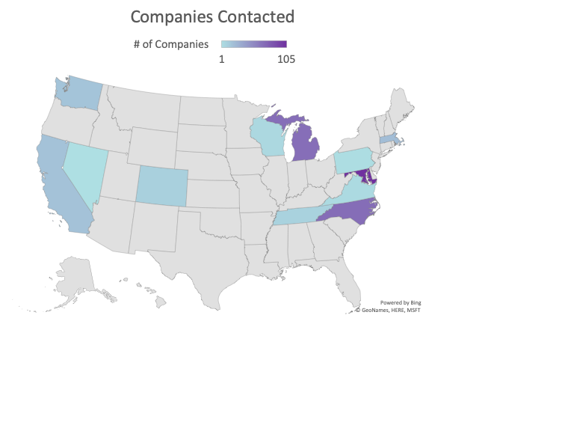
Slide Elements
Maps
Maps effectively display geographical data.
Uses
Geographical data such as location of companies contacted
Location of competitors or customers
Location of centers/institutes
Tips
Maps can be made directly in PowerPoint using latest version
Maps automatically define the region to include counties, states, countries, or continents
Maps are an aesthetically pleasing way to display geographical data and can be inserted using the latest version of PowerPoint (2018).
Back
Next

Slide 17




Slide Elements
Icons and tables
Icons and tables are commonly used in consulting data presentation to make the data less dull and easier to read.
Product: Nano Batteries
Market projection $243 million by 2026 with a growing CAGR of 35.7%
Anticipated to commercialize post-2020.
Annual Revenue:
$1B Expected 2020
400 patents for lithium technology
Composition: 1,000 customers in ~50 countries.
550 employees
U.S. companies in the nanowire battery market
Company A | Company F
Company B | Company G
Company C | Company H
Company D | Company I
Company E
Mergers: Three major
mergers have occurred.
Icons help draw the client to important information and highlights what is essential, while tables are an excellent way to break down text and number heavy information.
Back
Next

Slide 18















Slide Elements
Icons resources
There are lots of website providing stylish icons that are free to use.
Resources for free icons
Black and white icons: https://thenounproject.com/
Icons with color: https://www.flaticon.com/
Icons with customizable styles and colors: https://illustrio.com/
The websites above provide icons free to download if the integrated library in PowerPoint is not enough.
Back
Next

Slide 19
Slide Elements
Visual motifs
Visual motifs are often used to emphasize the logical relationship between topics, such as progression.
Process
Hierarchy
Step 1
Step 2
Step 3
Level 1
Step 1
Step 2
Step 3
Sideway
Level 2-1
Level 2-2
Level 2-3
Step 1
Step 2
Step 3
Circle
Factor 1
Pyramid
Level3
Factor 2
Factor 5
Level 2
Level 1
Factor 3
Factor 4
The advantage of visual motif is that it implies logical relationship between topics, which will be a good aid for the client to comprehend the message we want to convey.
Back
Next

Slide 20
Slide Elements
References
References must be added consistently throughout the presentation.
Reference Guidelines
References must be consistent and accurate across all slides
All non-common knowledge information must be properly cited
Reference superscripts should be hyperlinked to the source
The project manager will be responsible for the final consolidation of references in a list format
Hyperlink the source itself instead of the database (even if the source is behind a paywall)
e.g. To add reference to the total revenue of Coca-Cola, hyperlink this link instead of Kresge library or Nexis Uni database
Format in Slide Notes
Example 1
Example 2
1. “Page/Article Name”, URL, Access Date
2. “Title of Report”, Report Publisher, Date Published
1. “miLEAD partners with SpaceX in new venture”, www.milead.org/space, 14 Sep 2019
2. “Air Conditioner Market in ASEAN-6, Forecast to 2023”, Frost and Sullivan, 13 Sep 2019
References must be appropriately added for all non-common knowledge information and synthesized in a list for the client.
Back
Next
Notes:
1. “Coca-Cola total revenue in 2019”, https://w3-lexis-com.proxy.lib.umich.edu/newlexisdossier/companyreporting/start.do?prod=CD&cdcomp=f8a277370d84171336840628bfd5fd30:f8a277370d84171336840628bfd5fd30:6_T652969770&host=NewLexis&LC=US&entityId=1959404&reportKey=snapshot_report&ticker=KO&countryName=UNITED%20STATES&disclosure=&companyName=Coca-Cola-Atlanta&companysCountry=Public&sicCode=2086&desc=Bottled+and+Canned+Soft+Drinks+and+Carbonated+Water, 11 Nov, 2019

Slide 21
Slide Presentation
miLEAD Training Module
Basic features of miLEAD slide design | 3
Slide elements | 9
Example slides - Urinary Tract Infections | 22
Example slides - Agricultural Robots | 33
Next, example slides will be shown of a project scenario for a market analysis and competitive landscape analysis of antibiotic treatments for complicated urinary tract infections.
Back
Next

Slide 22
Example Slides - Urinary Tract Infections
Back
Next

Slide 23
Project Plan
Project Plan for Client
1
2
Product Indications
Commercialization Strategy
miLEAD will research and identify promising indications for [Product]. For each indication, analysis will include:
Applicability of product
Indication-specific competitor identification
Indication-specific market trends
miLEAD will compile information and sources related to SBIR Phase II Commercialization Plan. These will include:
General market trends
Market segmentation
TAM, SAM, and Target
Competitive landscape
SWOT analysis
Back
Next
Notes:
Explain this slide

Slide 24
Market Analysis
Market Overview: Demand
The slide below shows the need for this product based on percentage of antibiotic resistance.
Chronically recurring UTIs present increased risk of resistance, damage to gut microbiome, and hypersensitivity pneumonitis¹
Abscesses and abnormalities in urinary tracts present barriers to antibiotic penetrance ²
Current antibiotics do not treat underlying inflammation³
[Product] is well suited to reduce inflammation and increase penetrance into infected regions.
Back
Next
Notes:
1. “Danger of chronically recurring UTIs”, https://doi-org.proxy.lib.umich.edu/10.1517/13543784.2016.1161024, 24 Mar 2016
2. “Complicated Urinary Tract Infections”, https://www.ncbi.nlm.nih.gov/books/NBK436013/, 01 Jun 2020
3. “Uropathogen Resistance and Antibiotic Prophylaxis”, https://www.ncbi.nlm.nih.gov/pubmed/29954832, July 2018

Slide 25
Market Analysis
Market Overview: Growth and Drivers
The slide below shows information on market growth, segmentation and drivers.⁴
Global CAGR of 3.5%
Expected to reach $9.89 billion in 2023
Fastest growing in China and India
North America leads market, with Europe as a close second
Rest of world splits remaining 27%
Market drivers:
Increased detection methods
Diabetes
Increased catheterization
Health regulation shifts
Market segmented into urethritis, cystitis, and pyelonephritis
Targeting the US cUTI Market
270,200,000
Antibiotic Prescriptions
10,500,000
Total UTIs
1,000,000
Total cUTIs*
*Based on catheter associated UTI cases
UTI market shows modest growth centered around North America.
Back
Next
Notes:
4. “Urinary tract infections: epidemiology, mechanisms of infection and treatment options”, https://www.ncbi.nlm.nih.gov/pmc/articles/PMC4457377/, 01 May 2016

Slide 26
Market Analysis
Market Growth by Region
During a market analysis, you often need to identify the market growth by region ⁵.
8.8% of ICU infections are caused by Acinetobacter species globally
4.6%
Given that Acinetobacter infections are rarely seen outside of healthcare settings, assume that nearly all are HCAIs
4.6%
7.8%
1.9%
Global market for HCAI was $4.4 billion in 2017, so Acinetobacter treatment market is ~ $387 million [$4.4 billion * 0.088 = $387 million]
EMRA: Europe, Middle East, Russia, Africa
% indicates CAGR for HCAI antibiotic market
The estimated market for Acinetobacter is largest in EMRA, but fastest growing in the Asia-Pacific region.
Back
Next
Notes:
5. “Acinetobacter in Healthcare Settings”, https://www.cdc.gov/hai/organisms/acinetobacter.html, 13 Nov 2019

Slide 27
Market Analysis
Vertical Market Segmentation
The size and CAGR of each market sector can be represented in a visually pleasing as shown in this graph.
754
Skin & Skin Structure infection
605
Infections of Prosthetic Limbs
566
871
Increasing Applicability of [Product]
Hospital-Acquired Pneumonia (including VAP)
Sepsis⁶
(including Urosepsis)
442
Fever Neutropenia⁷
*intra-abdominal
infections excluded due to
lack of market size data
CAGR
Several indications for which [Product] is applicable have promising market size and growth.
Back
Next
Notes:
6. “Sepsis Diagnostic Market Size, Share & Trends Analysis”, https://www.grandviewresearch.com/industry-analysis/sepsis-diagnostics-market, Feb 2020
7. “Chemotherapy-induced Neutropenia Therapeutics Market”, https://apnews.com/324422083f61433993e698399503dfb6, 23 May 2018

Slide 28
Market Analysis
Market Share by Competitor
Pie charts can easily be broken down to show more detail of a given market⁸.
The top ten competitors in the antibiotics market only make up 40% of the total market, leaving room for smaller companies to penetrate this market.
Back
Next
Notes:
8. “Antibiotics: Global Markets to 2023”, https://www.bccresearch.com/market-research/pharmaceuticals/antibiotics-global-markets.html, Dec 2018

Slide 29


Competitive Landscape Analysis
Competitor Comparisons
Using a table is one way to compare the strengths and weaknesses of the client’s product to competitors.
 | [Product] | [Competitors 1-5]
Penetrates Biofilms
Low Dose Intracellular Activity
Novel structure
Half-life | 8-9 hrs | 1 hr | 4-6 hrs | 8-9 hrs | 5-7 hrs | 1-3 hrs
Gram Neg Activity
Gram Pos Activity
*includes Imipenem, Meropenem, and Doripenem **includes Ceftazidime-Avibactam, Ceftolozane-Tazobactam, and Meropenem-Vaborbactam
A minority of drugs that treat UTIs can penetrate bacterial biofilms effectively and several are not active against gram-negative bacteria.
Back
Next

Slide 30
Competitive Landscape Analysis
SWOT Analysis
Several strategies are provided based on the SWOT analysis of [Product] and Client.
SWOT Matrix | Strengths 1. Client’s expertise in SBIR writing 2. [Product] | X class of drug 3. [Product] | Y activity | Weaknesses 1. X of Compound 2. Y efficacy in humans
Opportunities 1. Funding ↑ for orphan drugs 2. Market ↑ in India and China 3. ↑ demand due to resistance | Market [Product] as a X class capable of treating Y bacteria and Z pathogens | Target specific rare or dangerous diseases in commercialization strategy
Threats 1. Difficult to secure venture capital 2. Many competitors in R&D | Apply widely for publicly-available funding while identifying best strategy for future revenue source | Consider pursuing shorter, less-expensive clinical trials and leverage providers’ freedom to operate after approval
[Product] has many desirable properties, but its X and the general challenges of commercializing antibiotics will be difficult to navigate.
Back
Next

Slide 31
Engagement
Final Findings and Recommendations
1
2
3
[Product] is most suitable for rare or dangerous indications
Commercialization of [Product] will require efficacy in an area of major unmet need
Challenges with clinical trial design may dictate pursuing “low-hanging fruit”
Complicated skin and skin structure infections
[Product]’s efficacy against X and Y pathogens are an advantage
Complicated urinary tract infections
Few compounds with X structure are in development
Orphan diseases and dangerous infections
Highest ROI
Most appropriate given the anticipated Y of [Product]
The US and Global markets for antibiotics are growing slowly
Antibiotic resistance will eventually create high demand
Introduction of incentives for antibiotic development is expected
Currently few programs available
The use of [Product] will be justified in few scenarios
[Product] will be multiple-folds more X than most other Y compounds
The vast majority of antibiotic clinical trials are performed strategically in one of few indications
Clinical trials for the indications in which [Product] is most justified suffer from several limitations:
Small patient pools
High patient mortality
Difficulty demonstrating non-inferiority
Long clinical trial lengths
Unclear endpoints
Back
Next
Notes:
Explain this slide

Slide 32
Slide Presentation
miLEAD Training Module
Basic features of miLEAD slide design | 3
Slide elements | 9
Example slides - Urinary Tract Infections | 22
Example slides - Agricultural Robots | 33
The project scenario for the following slides analyzes market strategies used by successful agricultural robot companies, focusing on competitive landscape analysis.
Back
Next

Slide 33
Example Slides - Agricultural Robots
Back
Next

Slide 34
Market Analysis
Market Strategies
Example of how market strategies can be visually represented.
Strategies Adopted by Key Players in Agricultural Robot and Drone Markets (2016-2018)
Fragmented market 🡪 many small, medium, and large companies competing
Preferred strategy is introduction of new technologies into existing product portfolio
Partnerships and collaborations allow for expansion in smart farming market
Product launches & developments
Partnerships, collaborations, & joint ventures
Business expansions
Mergers & acquisitions
Others
Successful agricultural robotics companies are focusing on expanding their product portfolios and forming partnerships to thrive in this intensely competitive market.
Back
Next
Notes:
References:

Slide 35
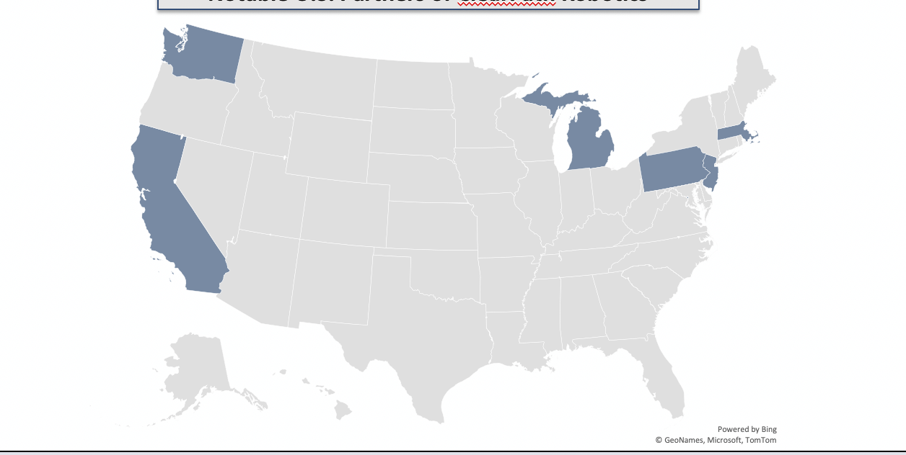









Competitive Landscape Analysis
Mapping Companies
Maps are a nice tool to highlight and annotate where the competitors are based.
Notable U.S. Partners of COMPANY
COMPANY is a major player in the robotic mobility platform market, with numerous companies, government agencies, and academic institutions utilizing their technology.
Back
Next

Slide 36



Competitive Landscape Analysis
Company profile
Tables and Icons are an easy way to represent major characteristics of a company that would be relevant to the client.
Specialty Crop Automation
Partnership with John Deere
Autonomous tractors for citrus orchard tasks (mowing, spraying)
Additional applications: disease detection, yield estimation, harvesting
Strawberry Plant Sorter
Automated plant sorter to streamline harvesting and improve efficiency
Uses air jets to sort plants into bins
Supported/adopted by California strawberry growers
Automated Tree Inventories
Vehicle-mounted sensors to count/map tree location in an orchard
Replaces tedious process of manual counting
Lidar and GPS system, tree modeling algorithm
Through various partnerships, COMPANY has facilitated the development of agricultural robotic technologies for harvesting and data collection, among other tasks.
Back
Notes:
References:

